Slide 1
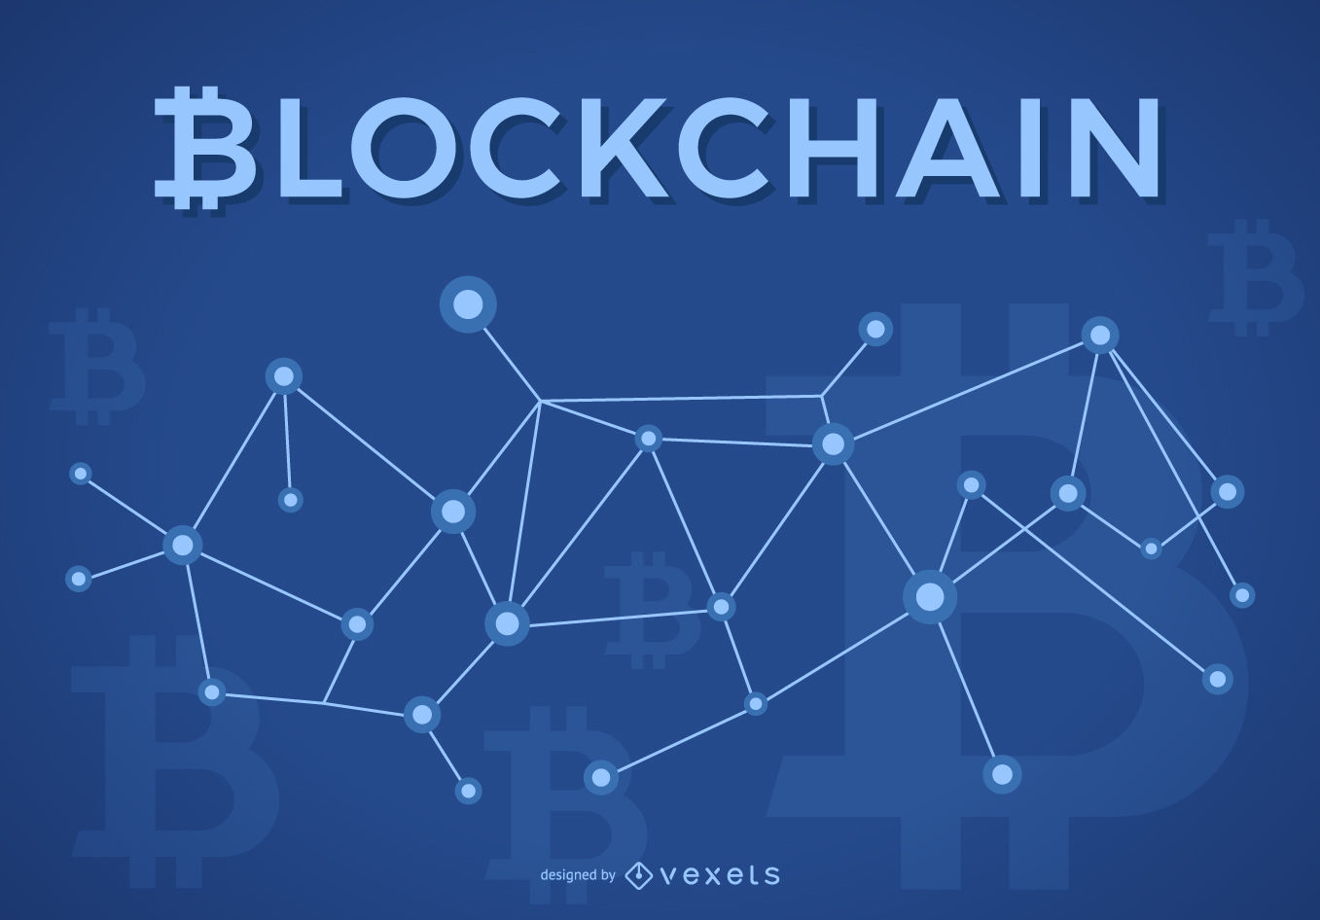
Group Members:
Yasir Hussain 19k-0223
Mukand Krishna 20k-0409
Bhavnesh Deep 20k-1085
Bahadur Khan 20k-1081

Slide 2

What is BlockChain?
BlockChain is a growing list of data blocks that are linked together, just like a chain.
The Old blocks are never altered, removed or destroyed.
Each Block know the information of the previous Block in the chain.

Slide 3
Bitcoin BlockChain
Bitcoin is just an application of the blockchain.
It is a data structure, which stores blocks.
Notes:
Bahadur khan

Slide 4
Features of Blockchain
Decentralized No one Own it.
Open to All For ALL!
Creating Witnesses Everyone Sees
Unbreakable Unhackable

Slide 5
BLOCKCHAIN
Cryptography
Security
CryptoCurrencies

Slide 6

What is Cryptography?
Technique of securing information and communications.
Set of rule based calculations called Algorithms

Slide 7

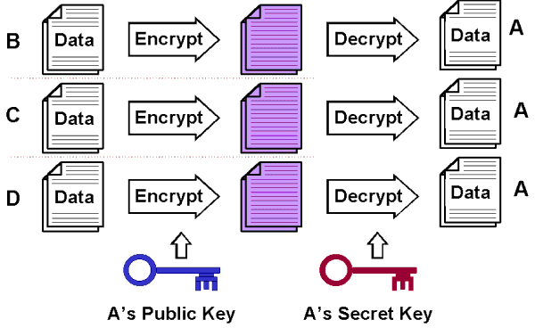
Process of cryptography

Slide 8
Features OF CRYPTOGRAPHY
Authentication: The process of proving one's identity.
Confidentiality: Ensuring that no one can read the message except the intended receiver.
Integrity: Assuring the receiver that the received message has not been altered from the original.
Non-repudiation: A mechanism to prove that the sender really sent this message.

Slide 9
Types of cryptography
Secret Key Cryptography
Hash Functions
Asymmetric Key Cryptography

Slide 10
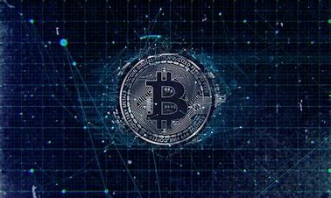
What is Cryptocurrency ?
A cryptocurrency is a digital or virtual currency that is meant to be a medium of exchange.
Technique used to secure the network.

Slide 11

What makes cryptocurrency special ?
Little to no transaction cost
You have 24/7 to access money
No limit on purchase and with draw
Freedom for any one to use
International transaction are faster

Slide 12
Types of cryptocurrency
Bitcoin
Ethereum
Ripple
Lite coin
Monero

Slide 13


For example : Bitcoin
Both a cryptocurrency and an electronic payment system
Satoshi Nakamoto in 2018
First decentralized payment network
System is peer-to-peer
21 million bitcoins
completely open source
1BTC = $57546.30

Slide 14
Bitcoin Technology
Distributed ledger technology
Mining
Mining hardware
Mining software
Blockchain
Bitcoins wallet

Slide 15
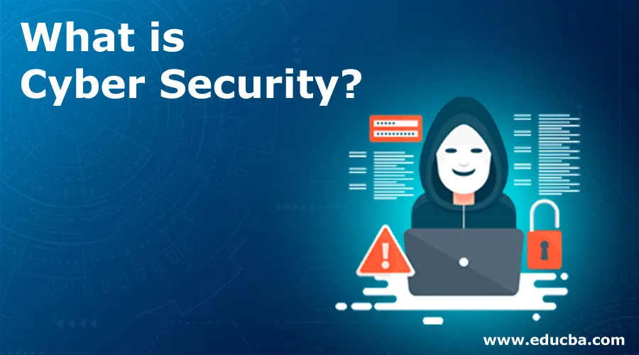


Slide 16



Slide 17
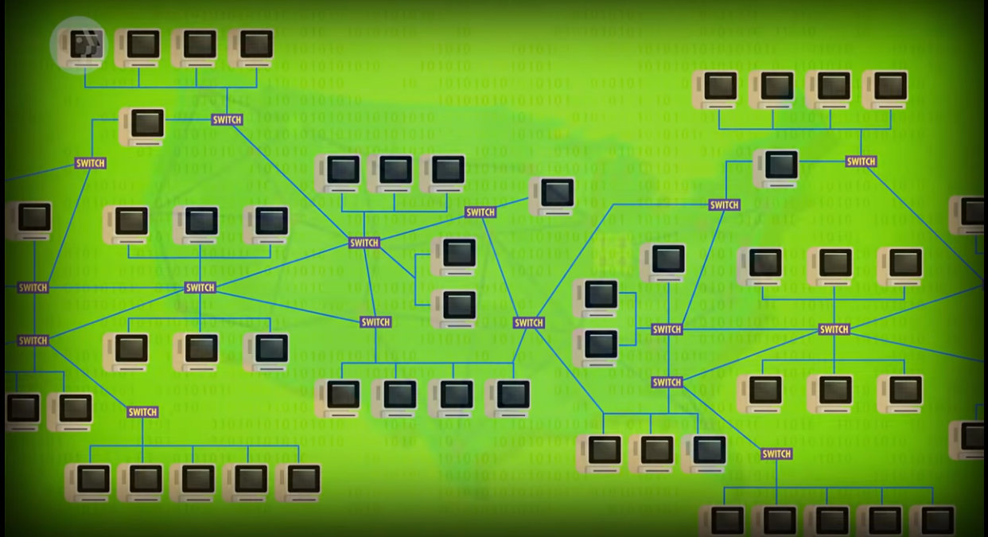

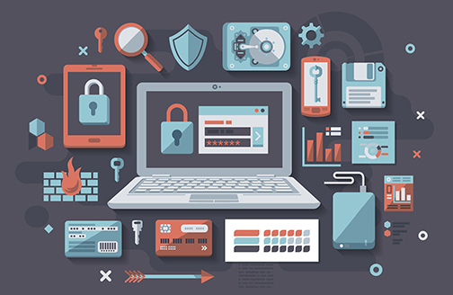

Slide 18
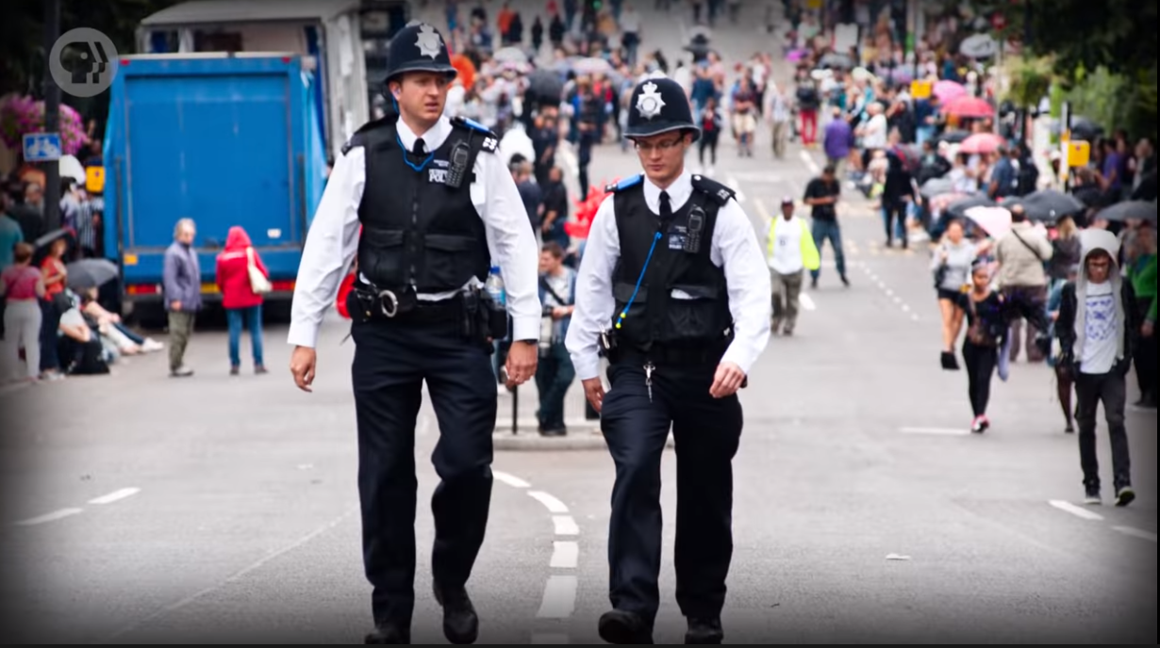

Slide 19
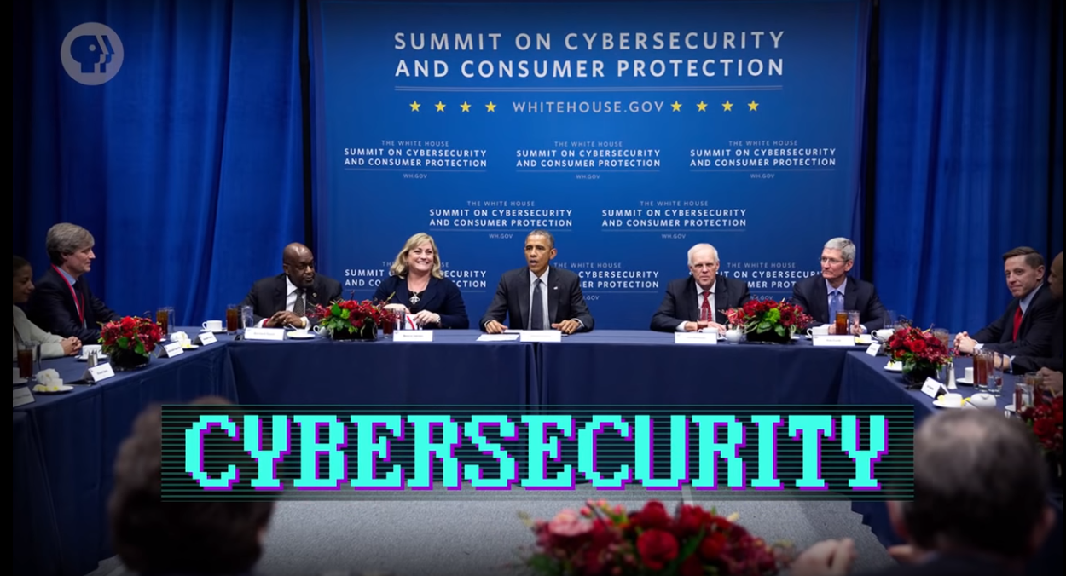

Slide 20


Slide 21
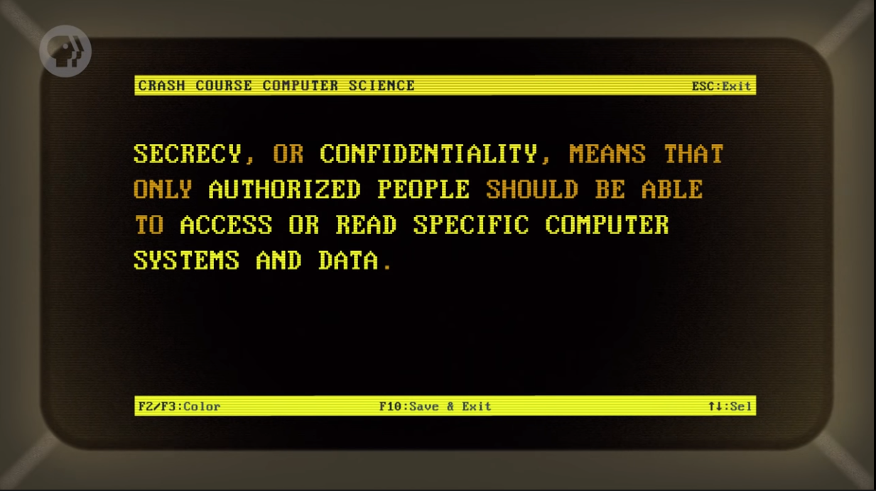

Slide 22
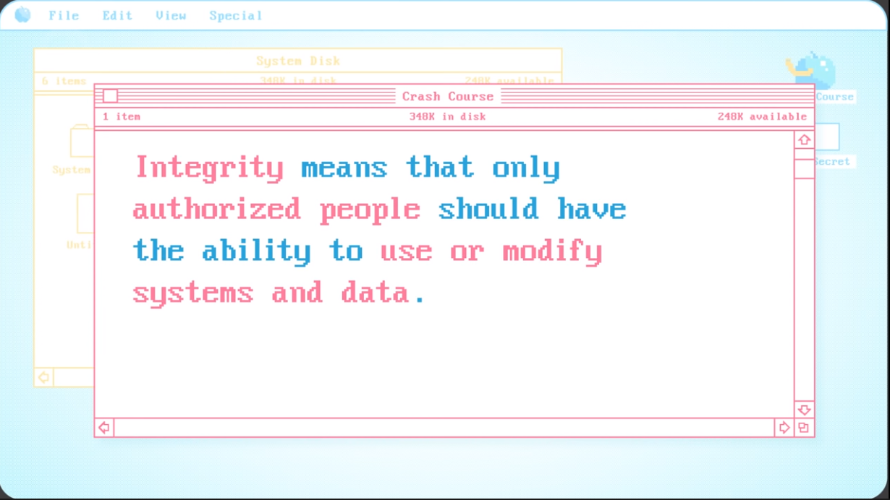

Slide 23
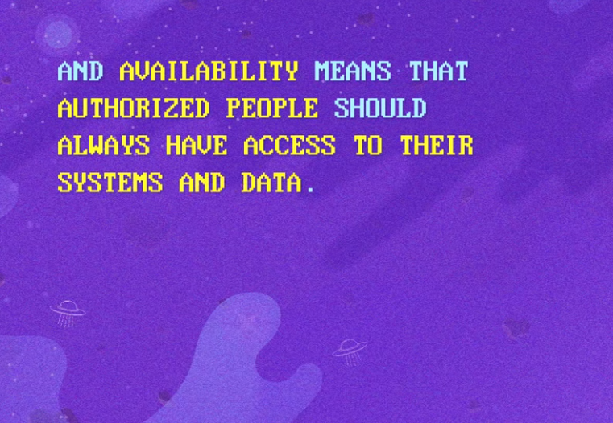

Slide 24
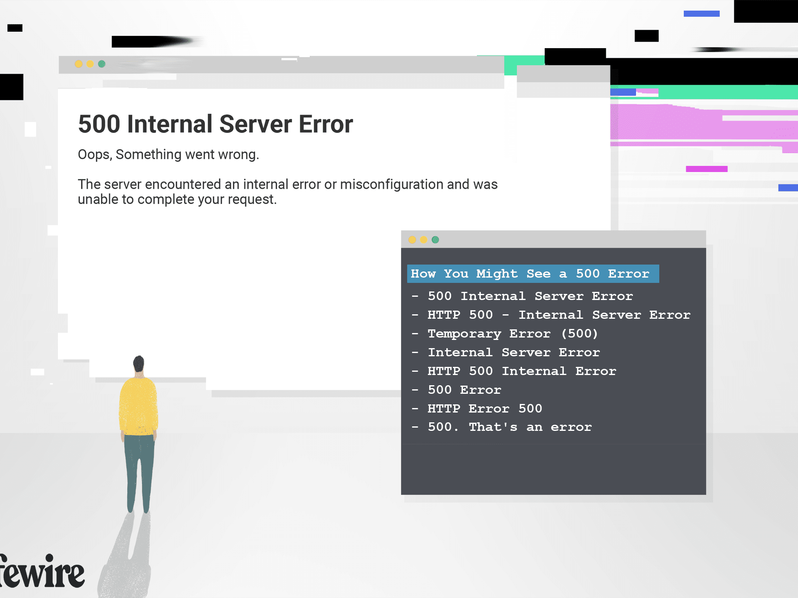

Slide 25
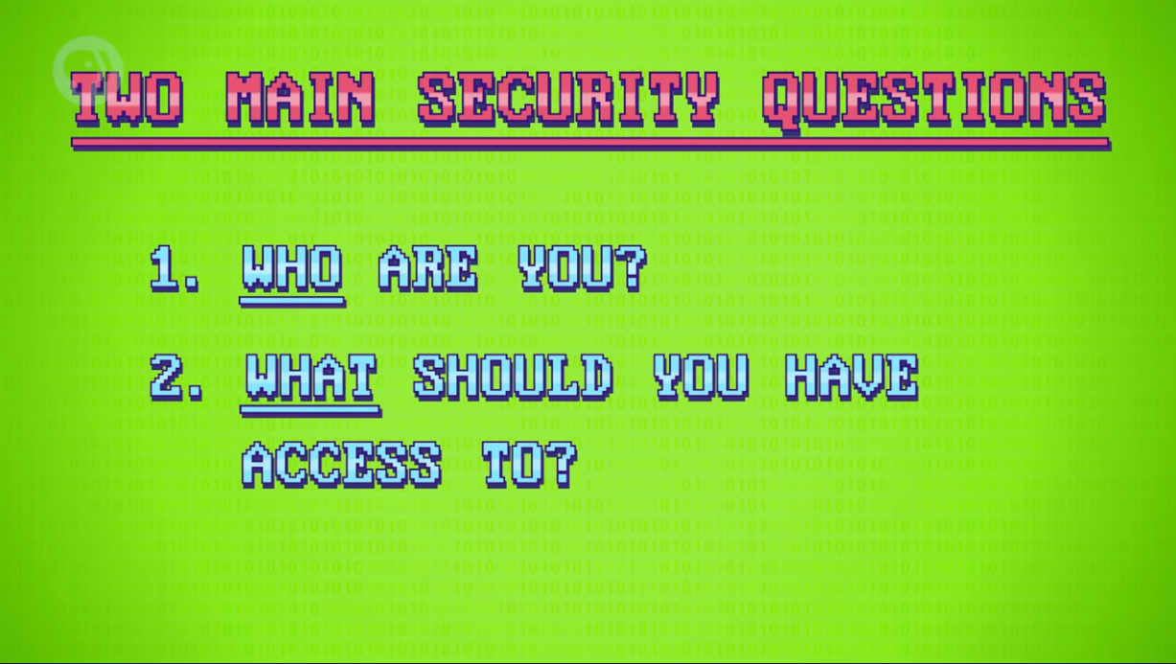

Slide 26


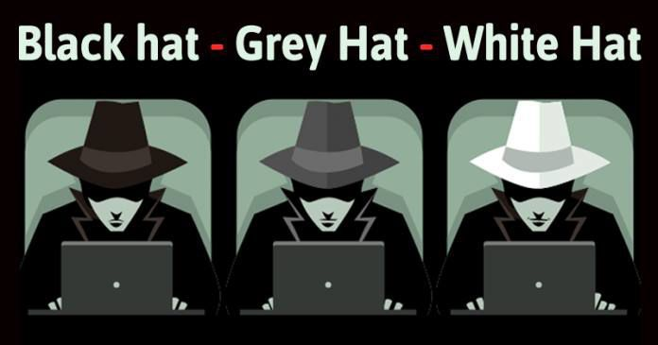


Slide 27
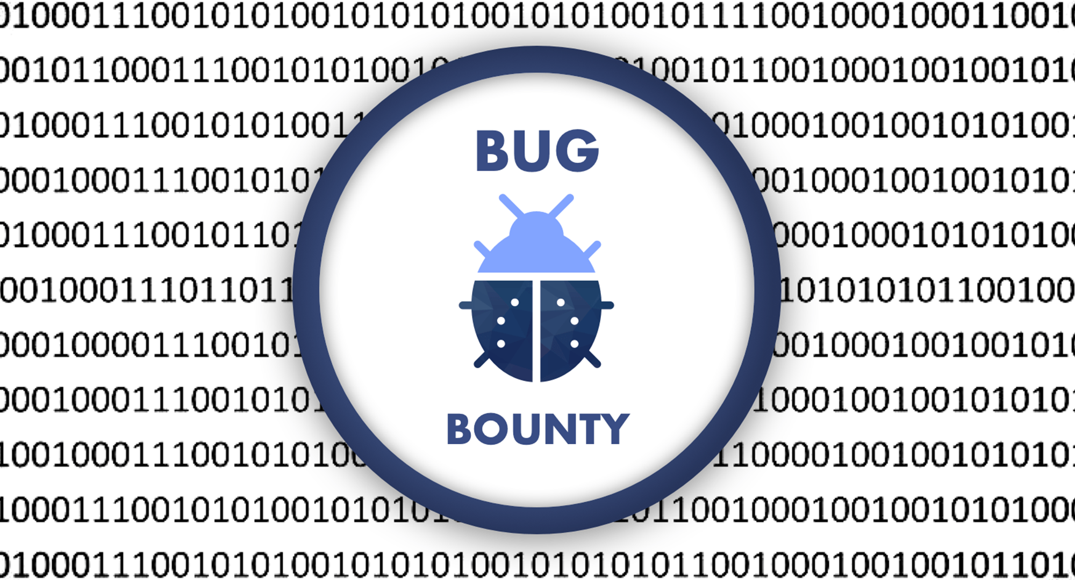

Slide 28
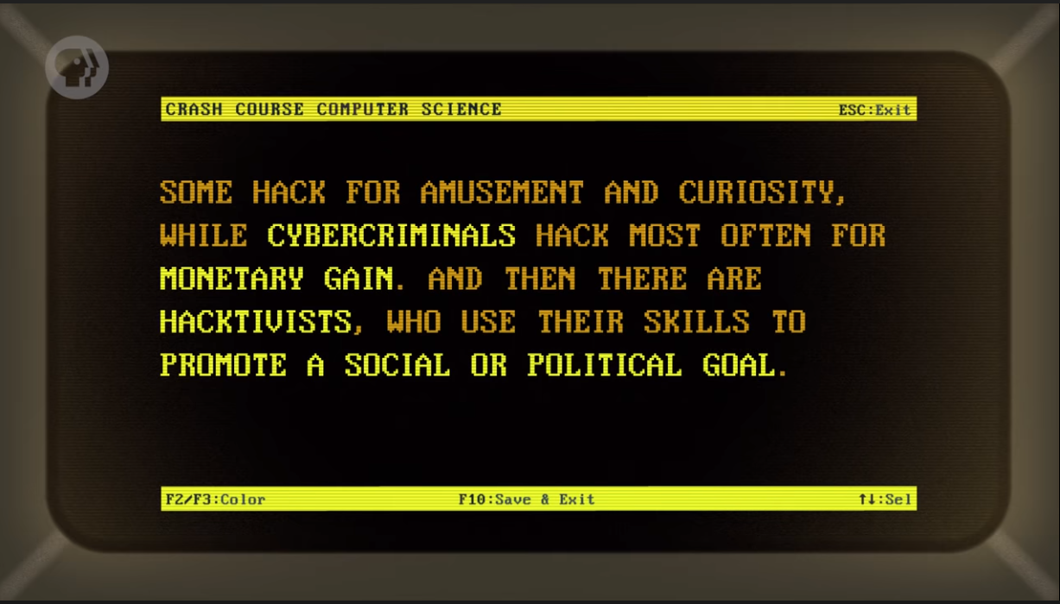

Slide 29
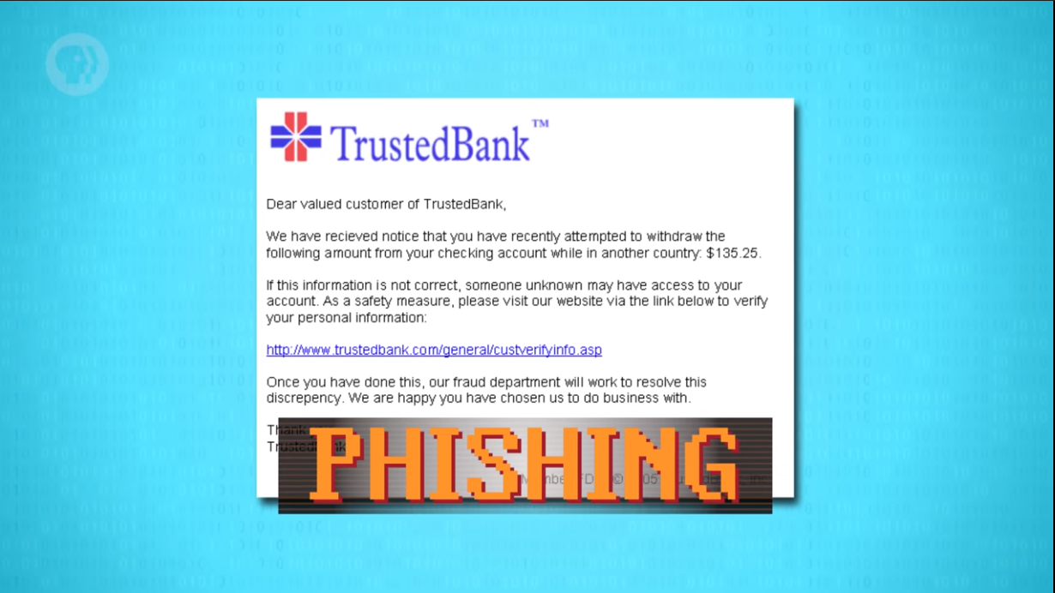

Slide 30


Slide 31
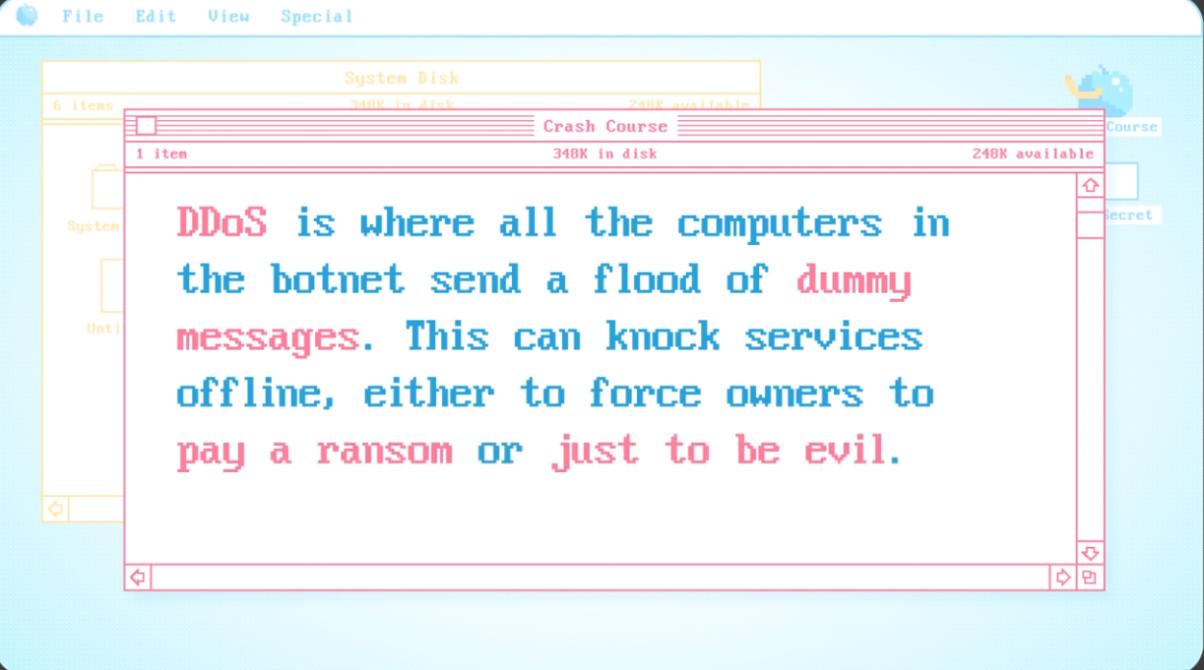

Slide 32
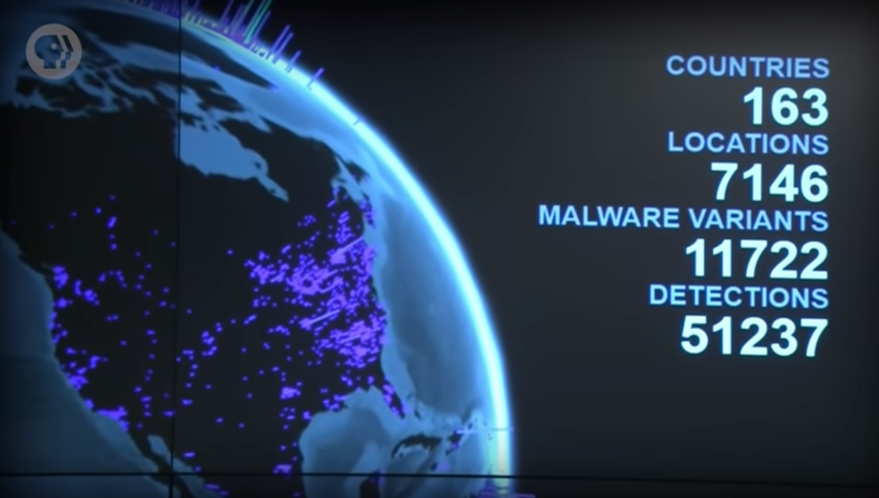

Slide 33
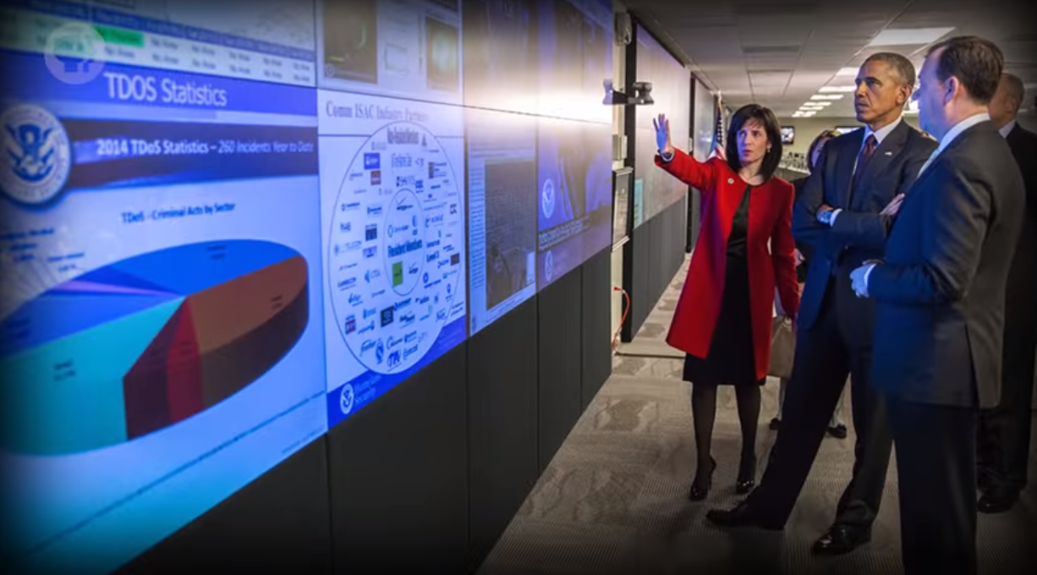

Slide 34
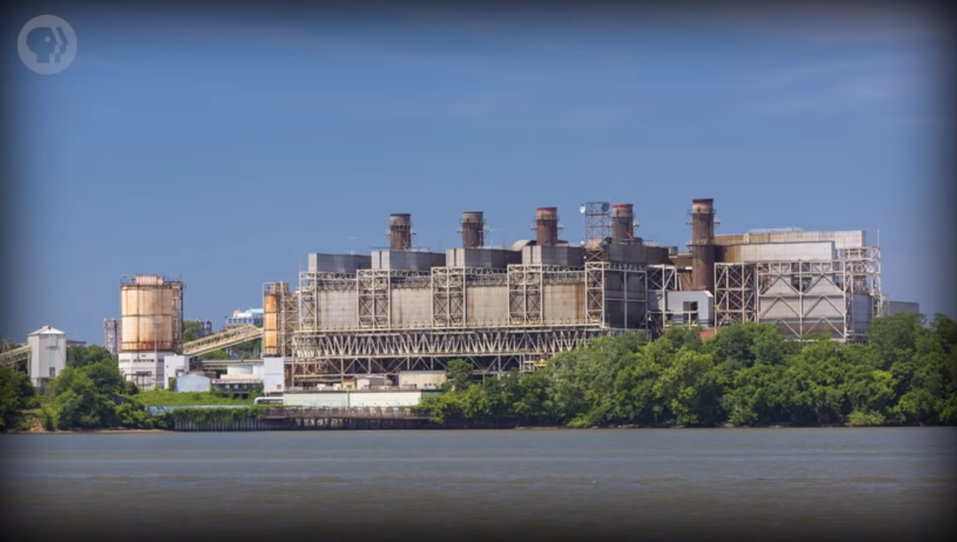

Slide 35
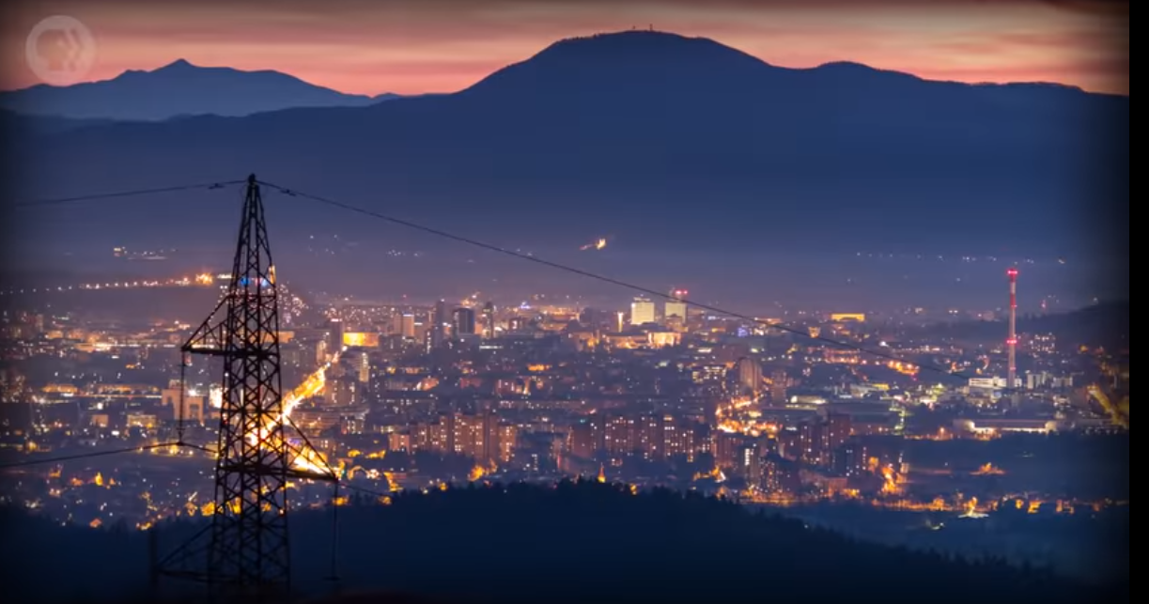

Slide 36
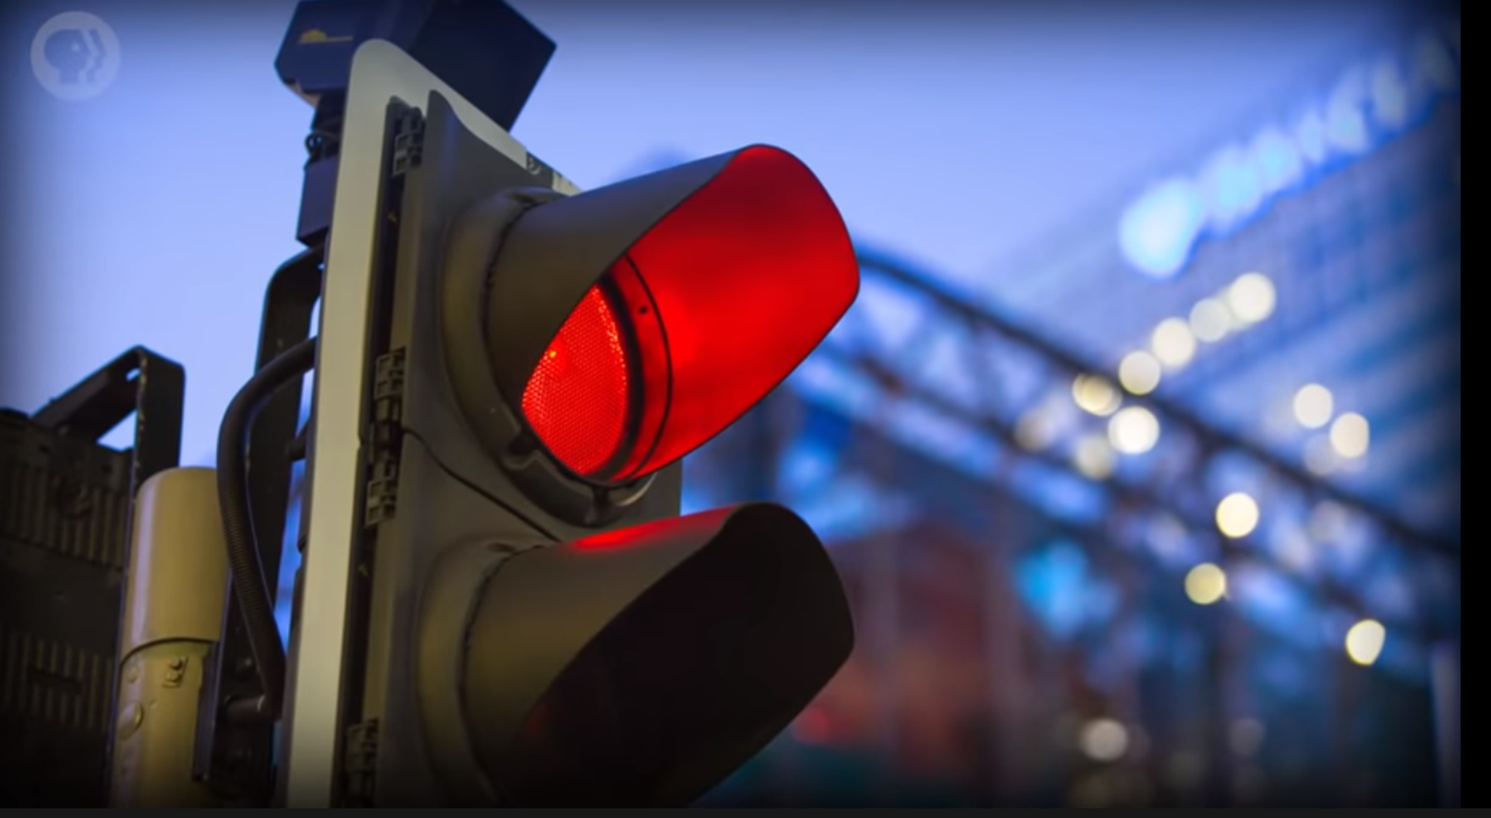

Slide 37
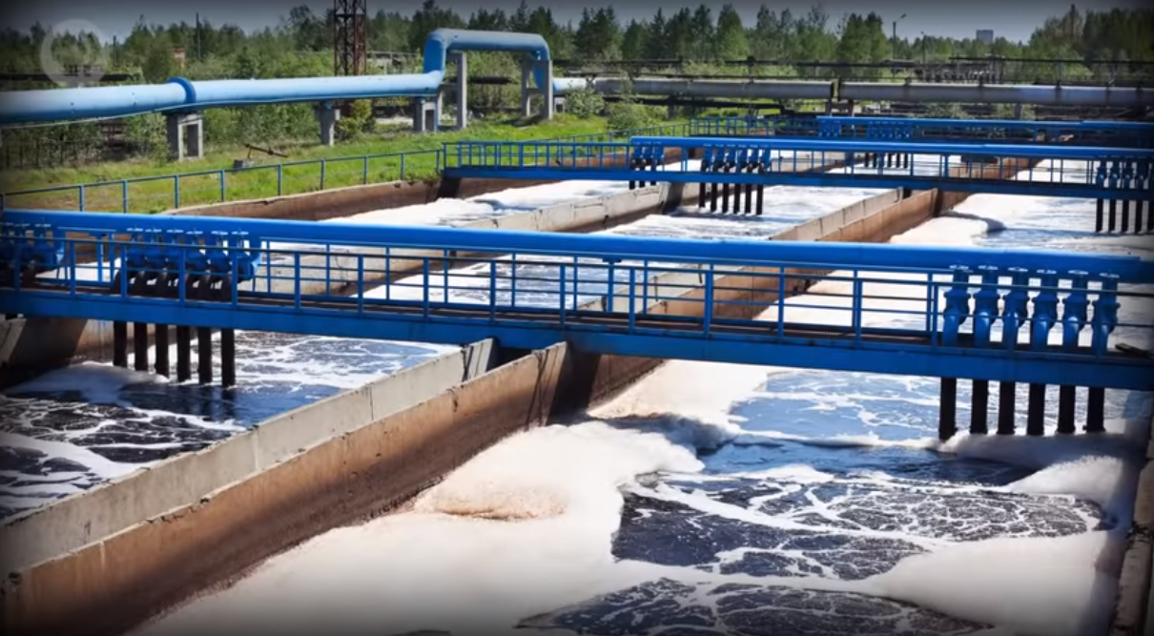

Slide 38
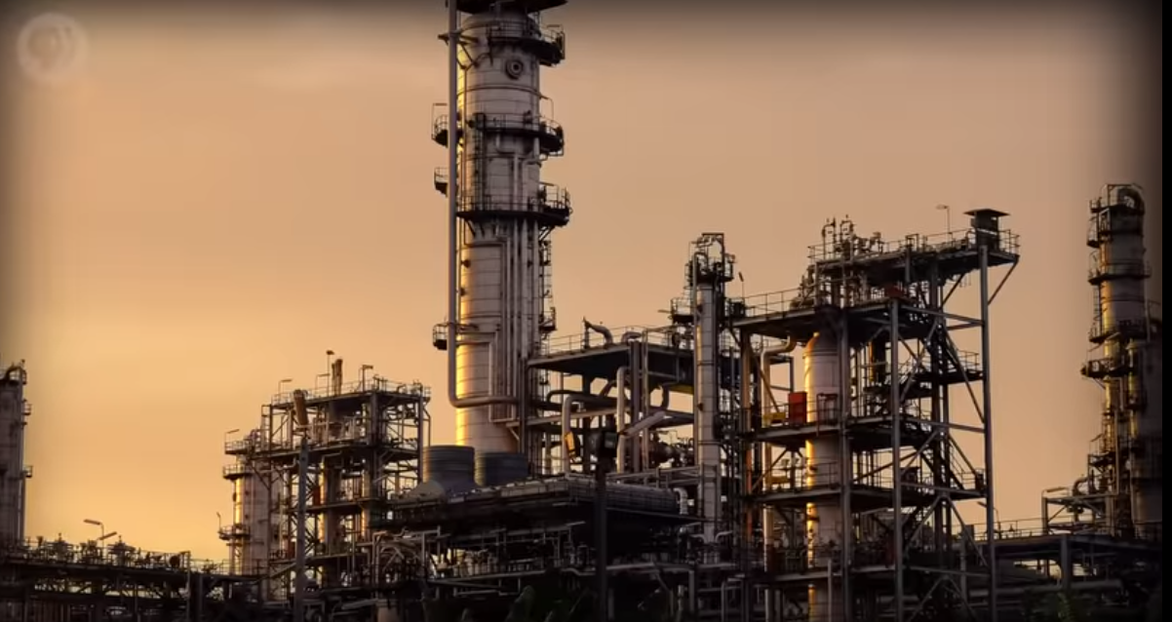

Slide 39
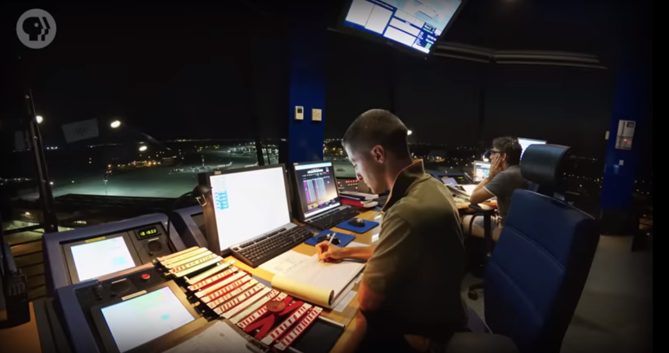

Slide 40
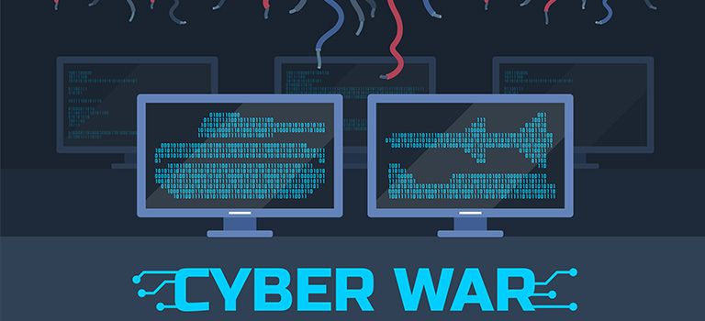

Slide 41
Thanks

